Slide 1
8/5/25

Slide 2
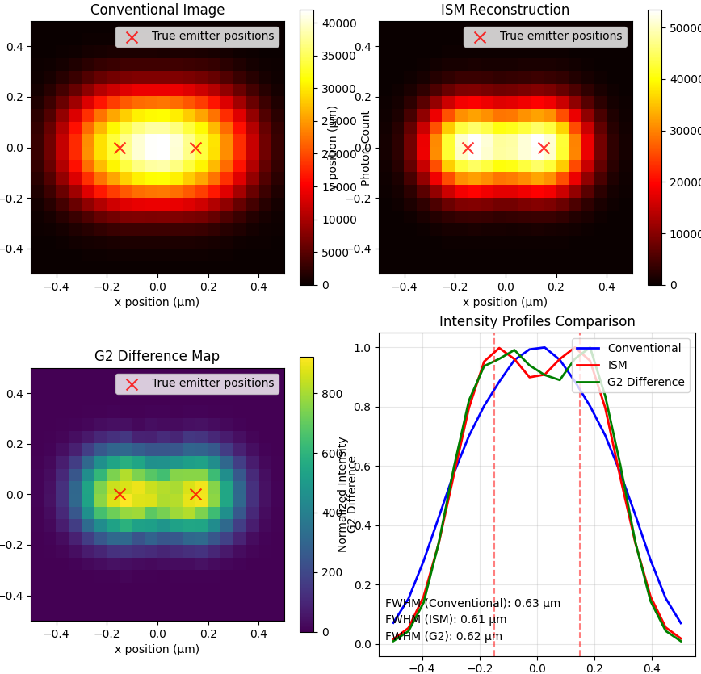
Comparison PSF I_confocal, I_ISM, G_d

Slide 3
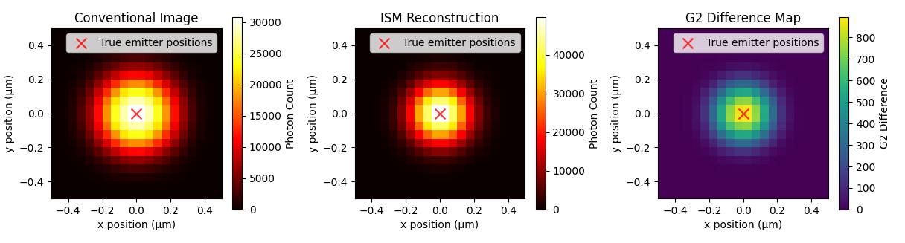

Slide 4
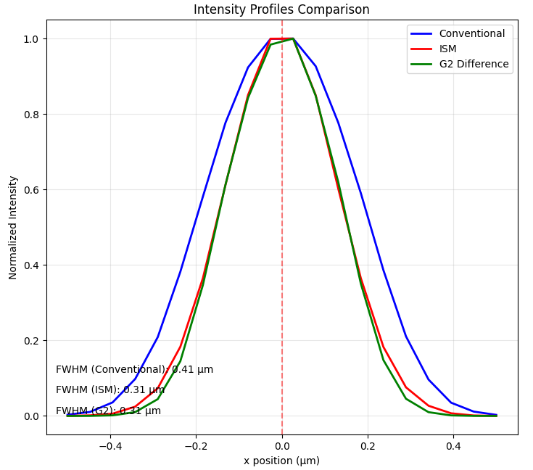

Slide 5
Fixed issue that caused very high g2(0)/G2(0) at places that had contributions from emitters at the same distance from 2+ emitters

Slide 6
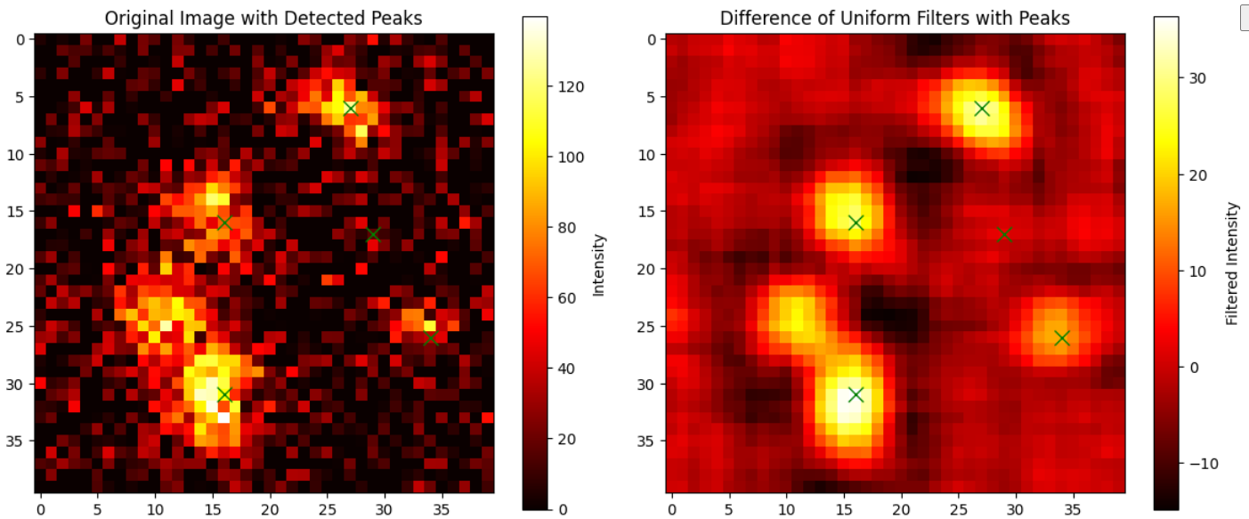
Uniform filter

